Slide 1
Lava Flows and Yardangs on Mars
Student Presenter: Jade Bowers
Project Advisor: Christopher Hamilton
Lunar and Planetary Laboratory, University of Arizona
NASA Space Grant Consortium
University of Arizona, Tucson, Arizona
April 16, 2016

Slide 2
Overview
Geologic features in the Elysium Planitia provide information on:
Geologic unit
Change in climate and stability of H₂O
Methodology:
Geologic Mapping
Medusae Fossae Formation
Athabasca Valles Flood Lava
Convolutional Neural Networks
Classification of features indicating lava-water interaction

Slide 3
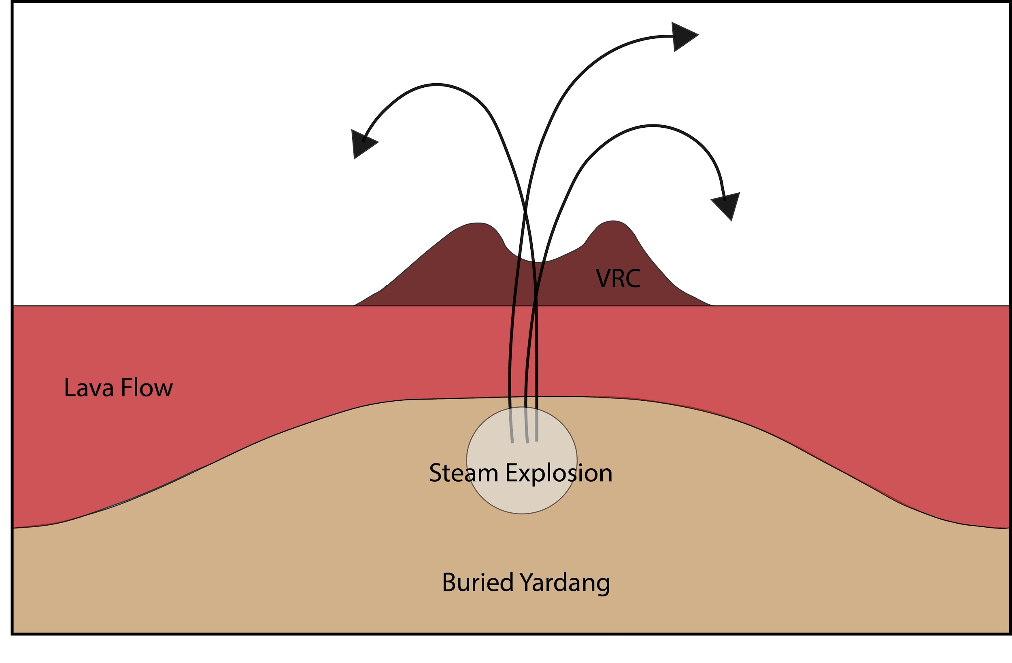
Geological Context
Correlation between presence of Volcanic Rootless Cones (VRCs) within the Athabasca Valles Flood Lava (AVFL) and yardangs within the Medusae Fossae Formation (MFF)
Insight into the stability of liquid water and ice on Mars and the evolution of its climate

Slide 4
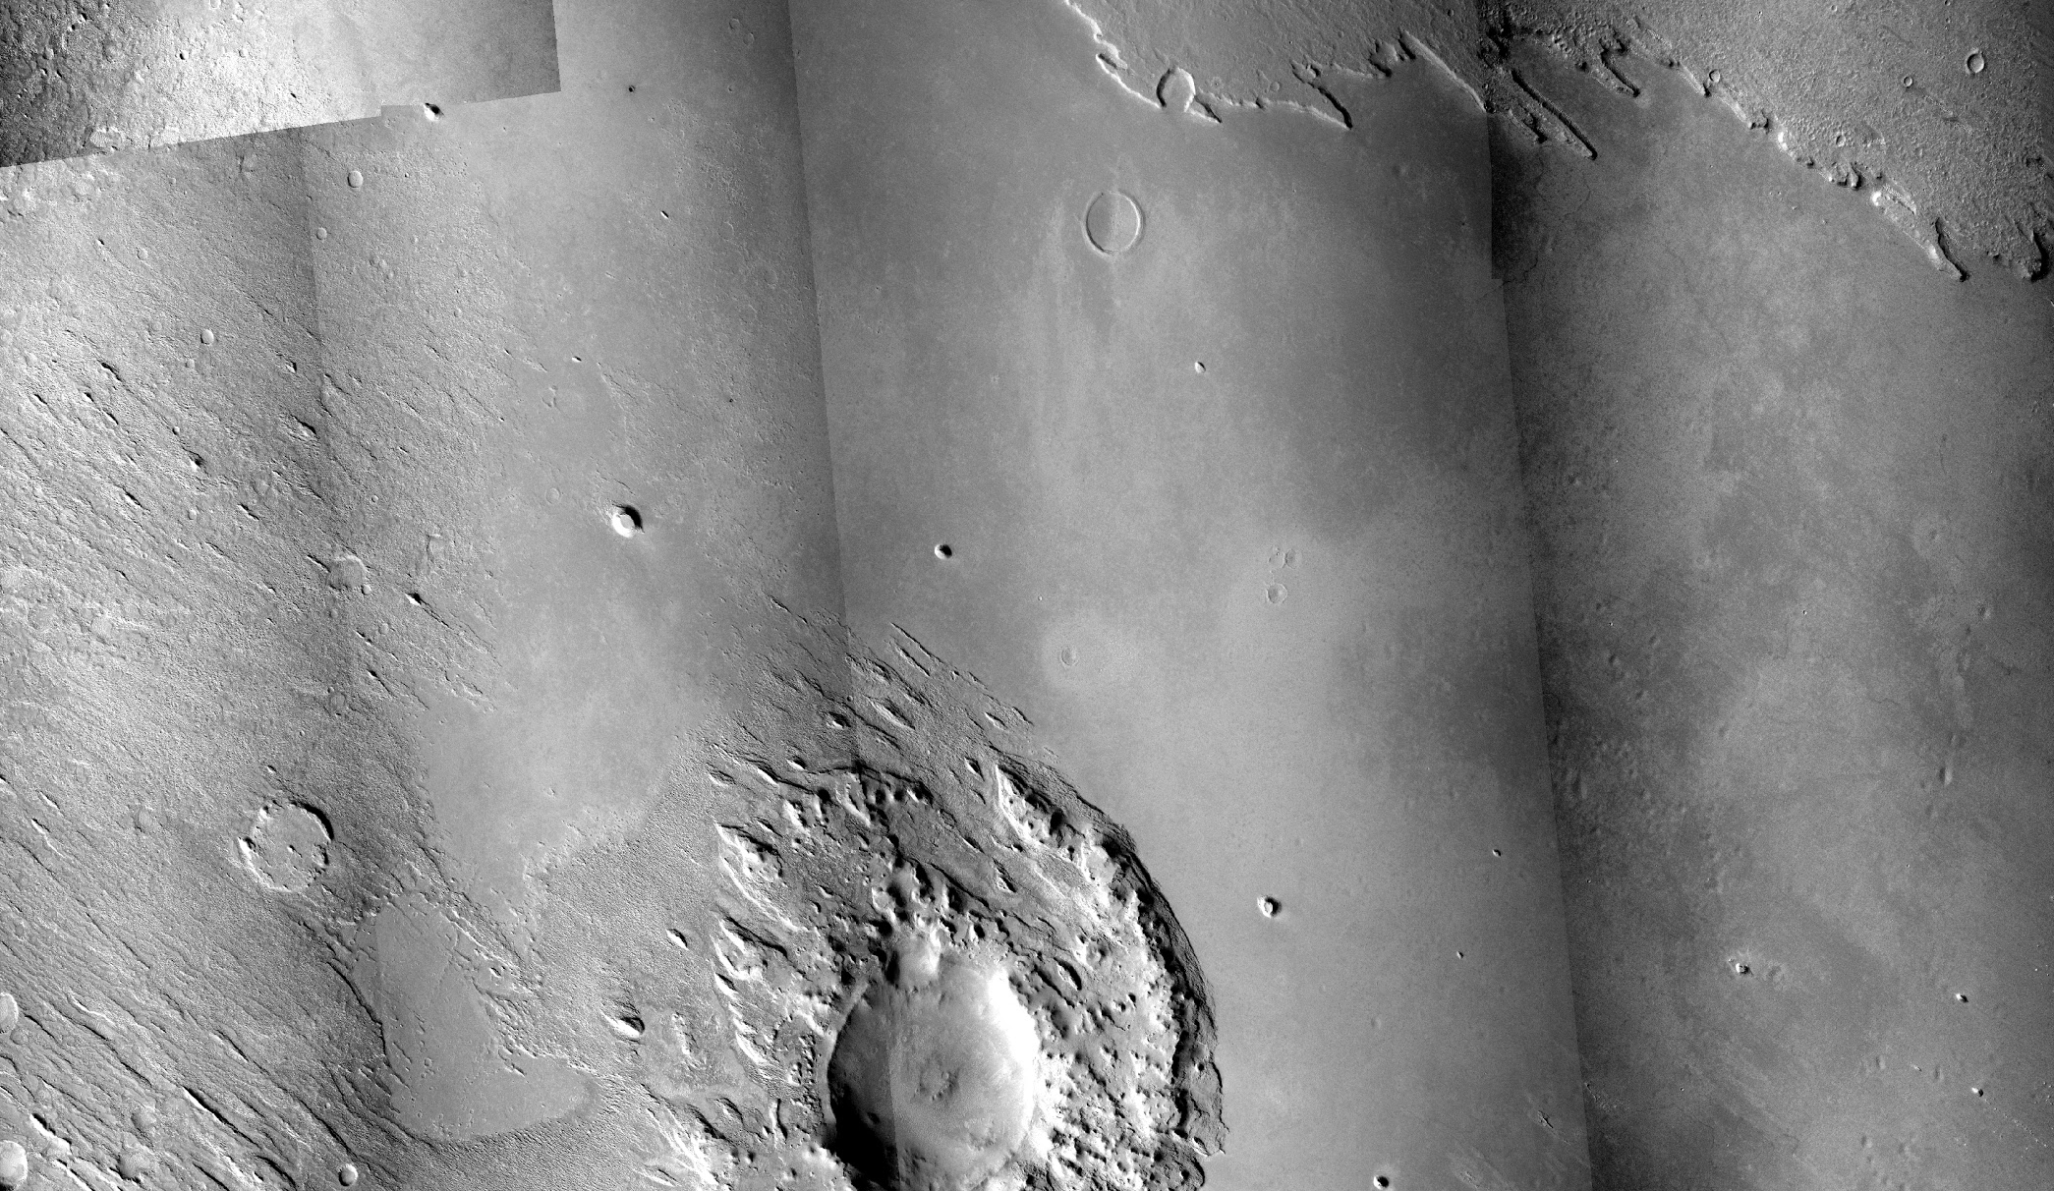
Geological Context
MFF
AVFL
MFF
16 km

Slide 5
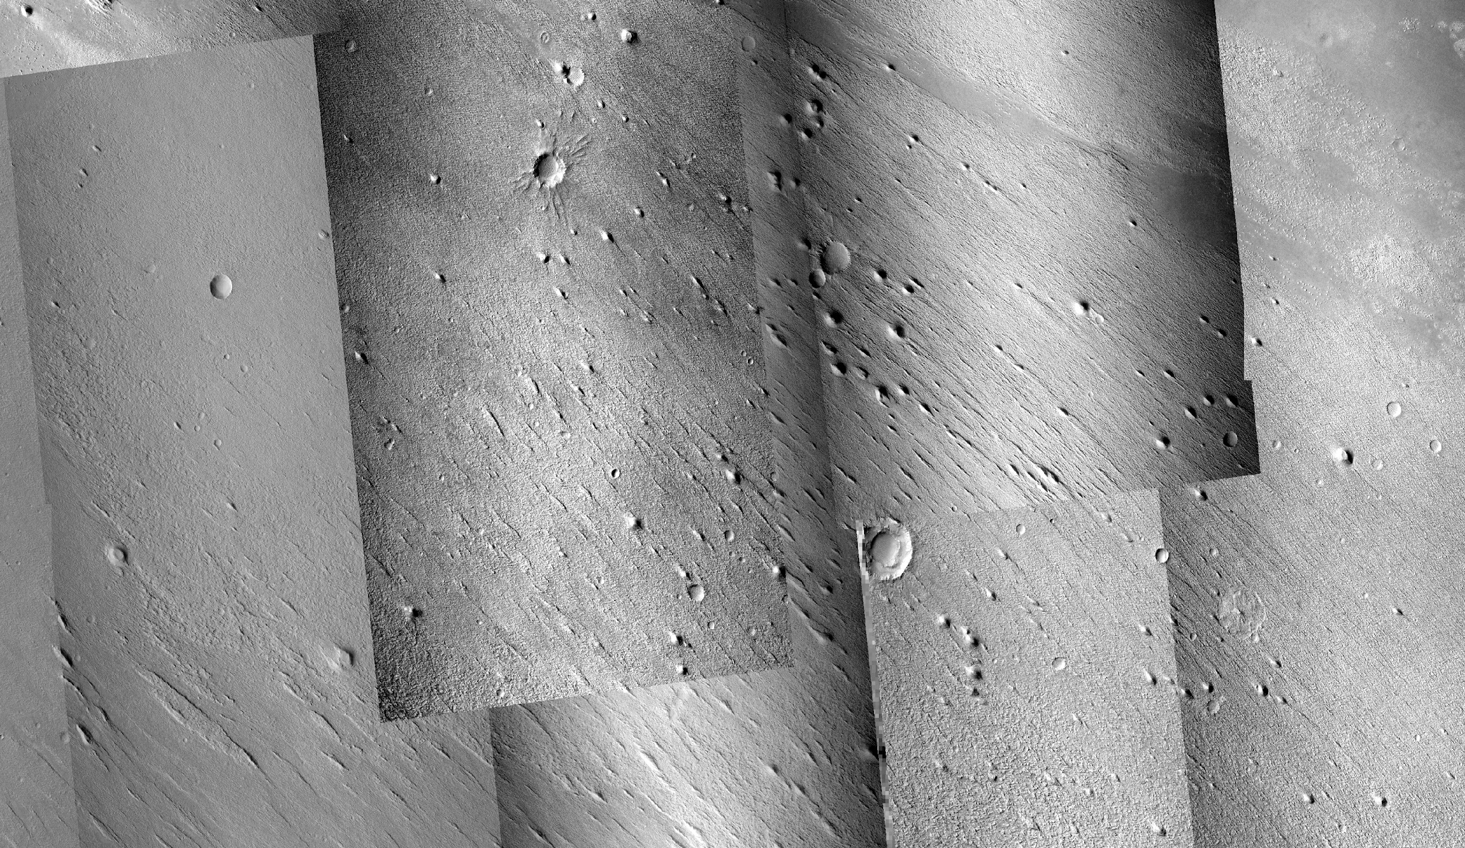
Medusae Fossae Formation
12 km

Slide 6
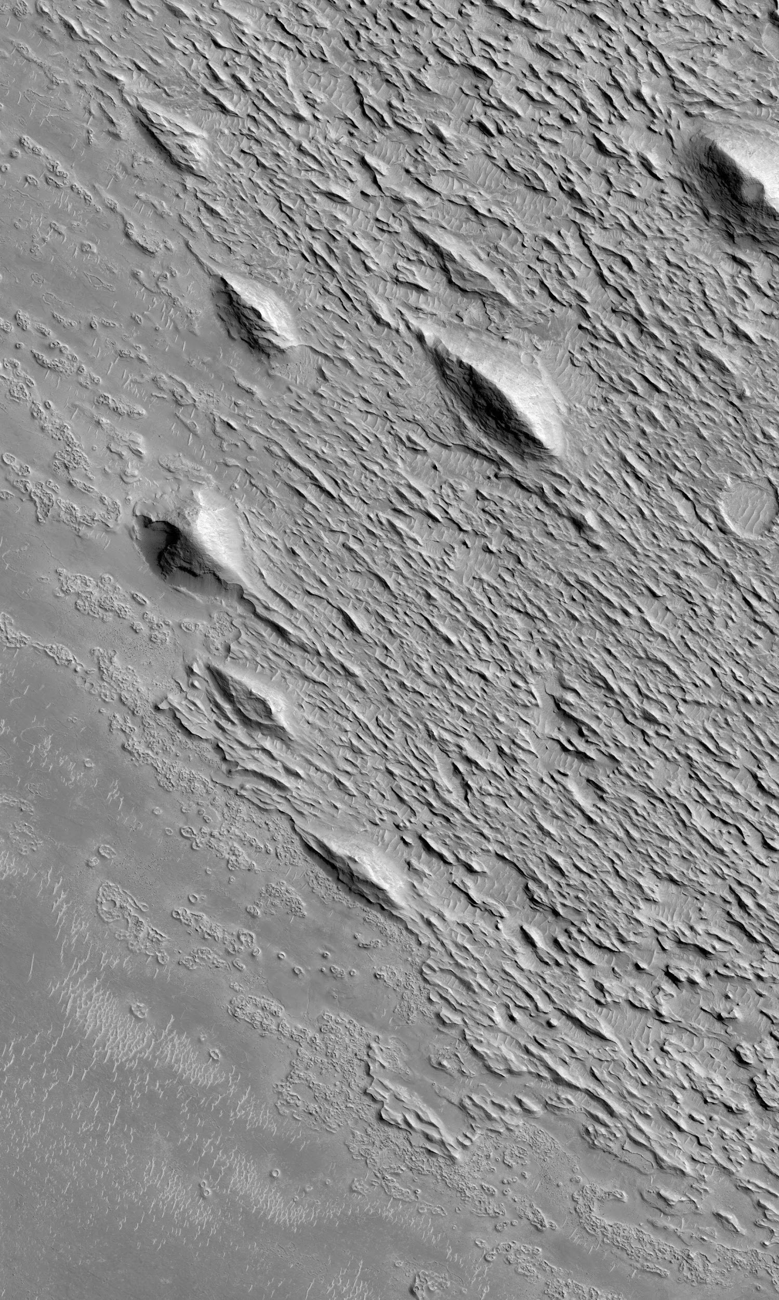
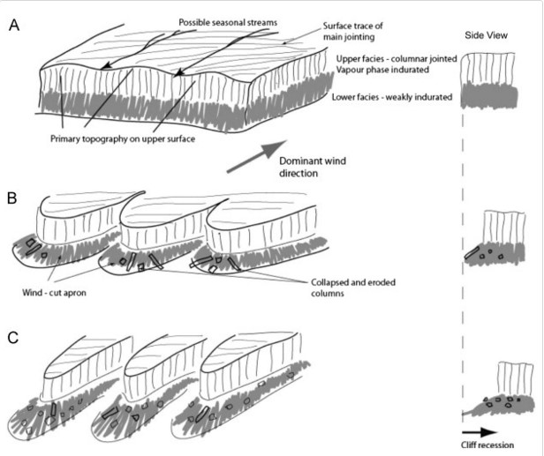
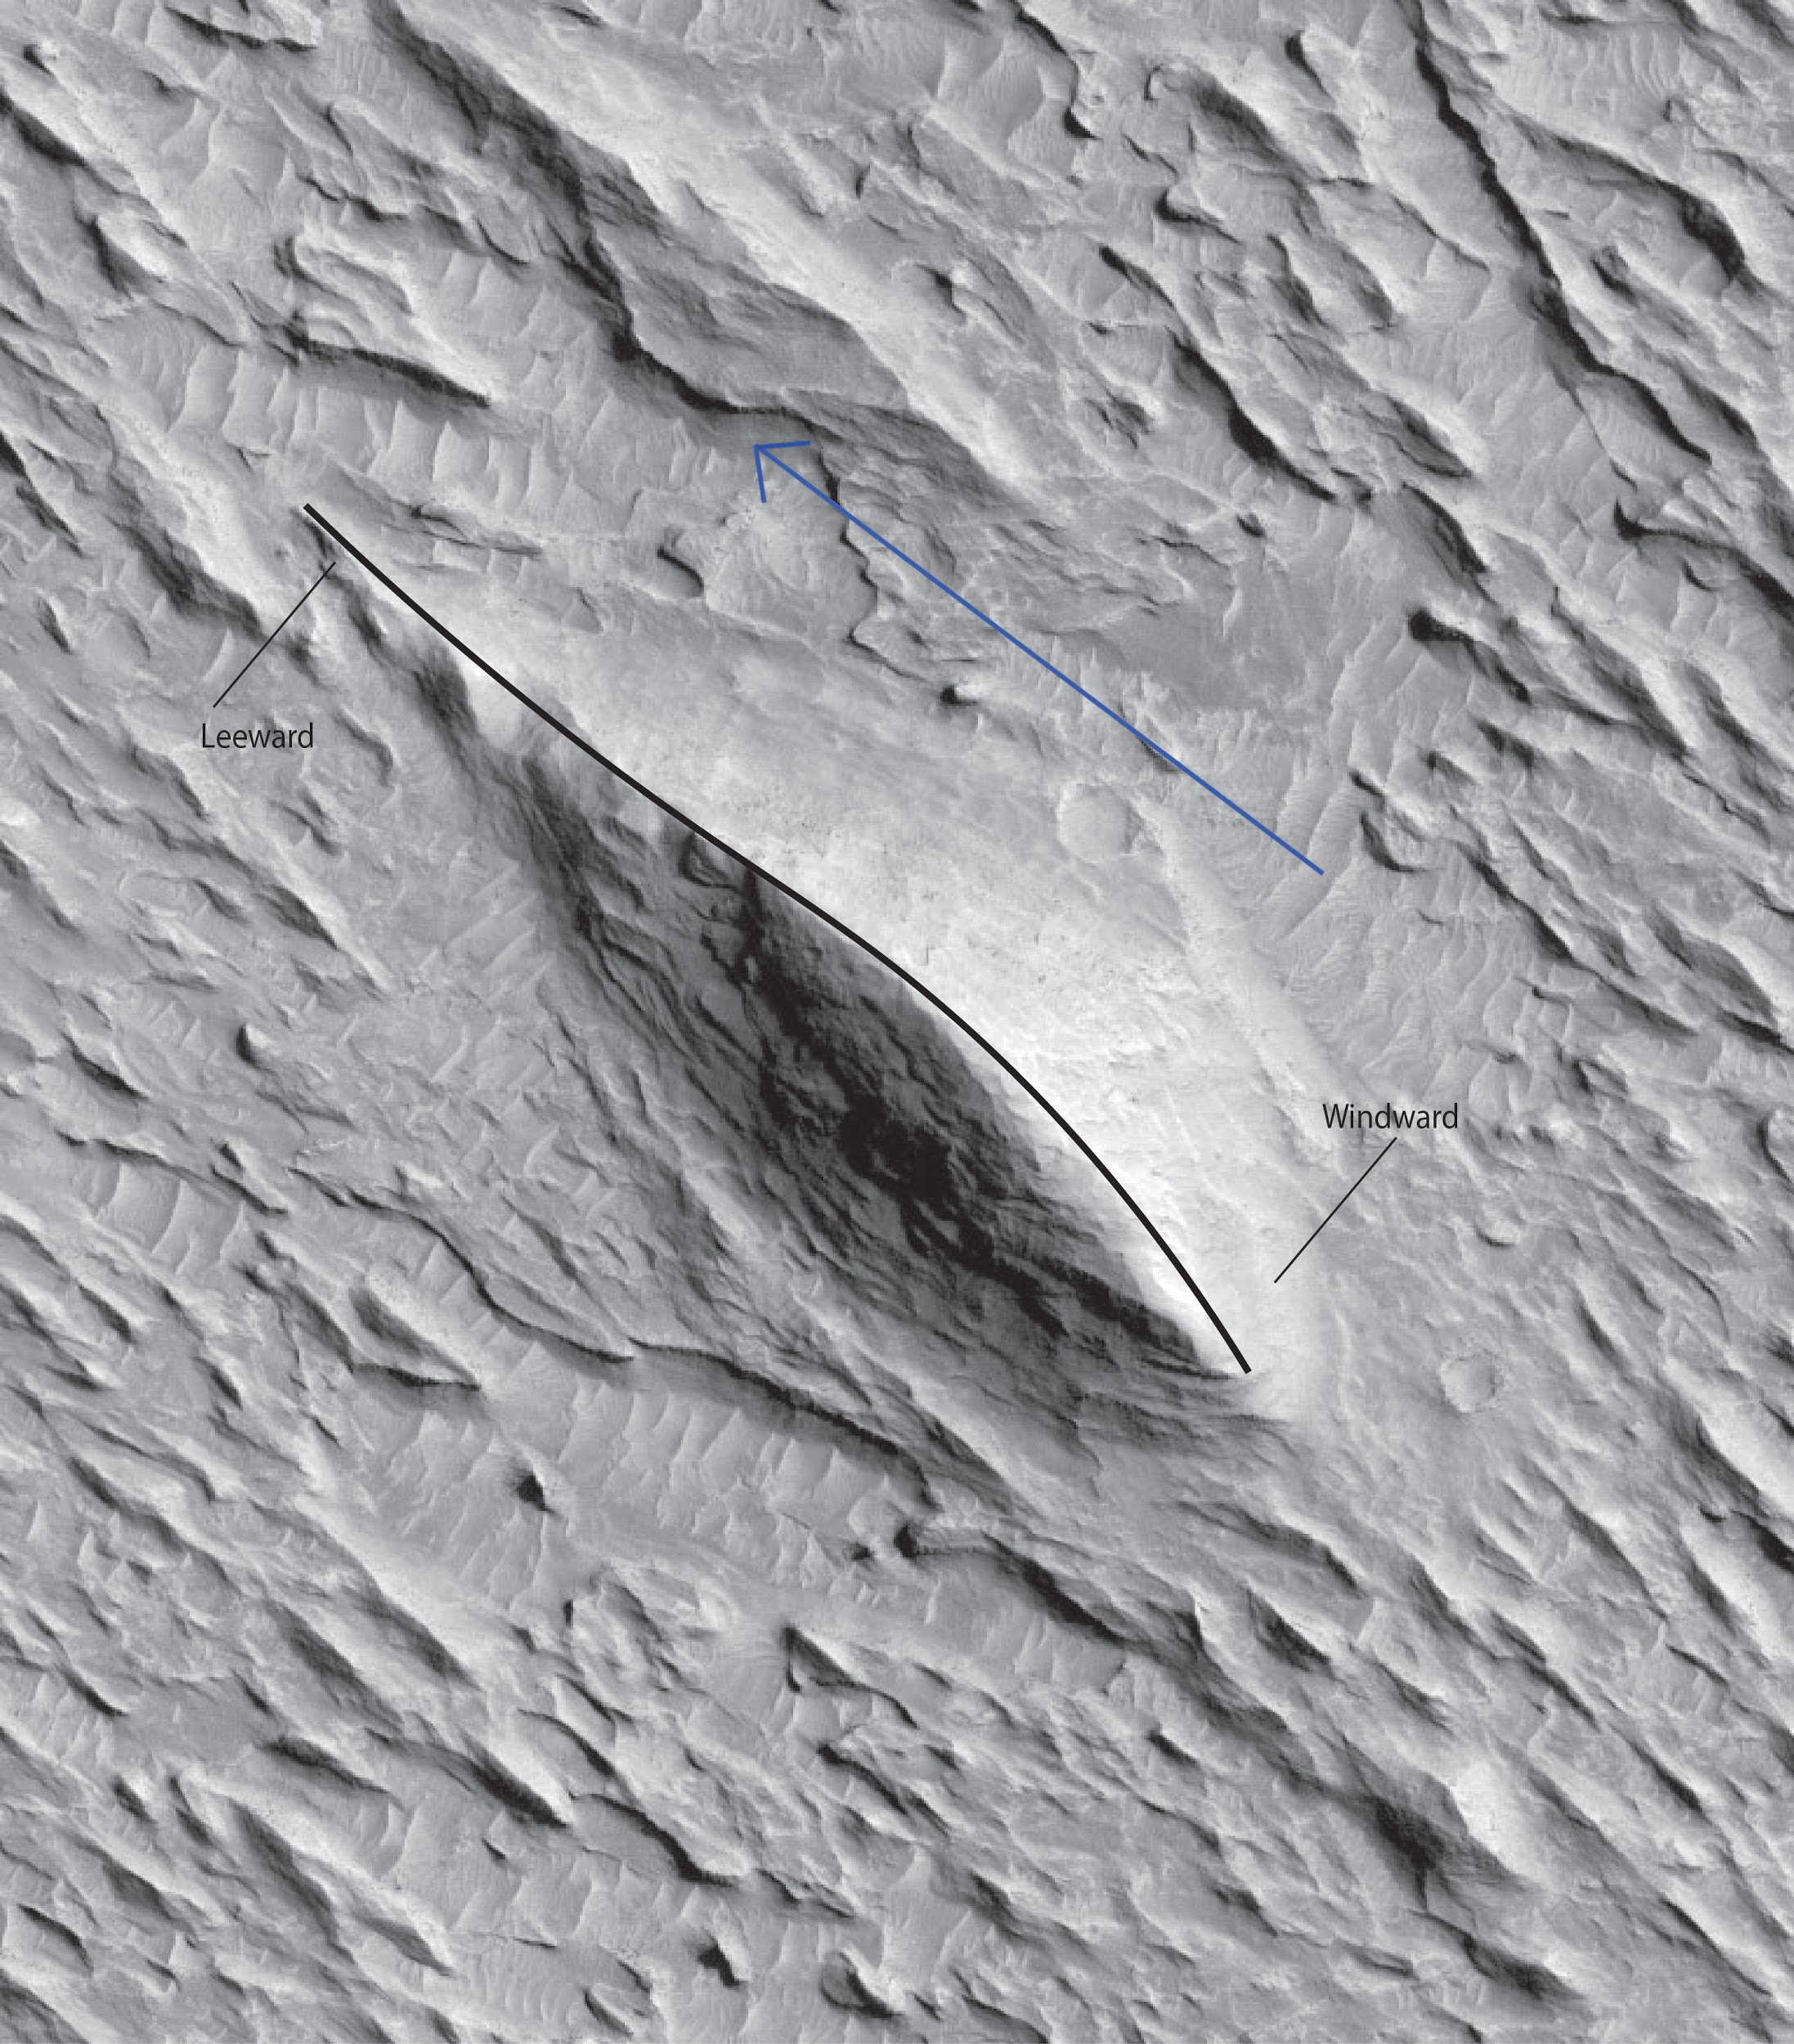
Yardangs
(de Silva et al., 2010)
1 km

Slide 7
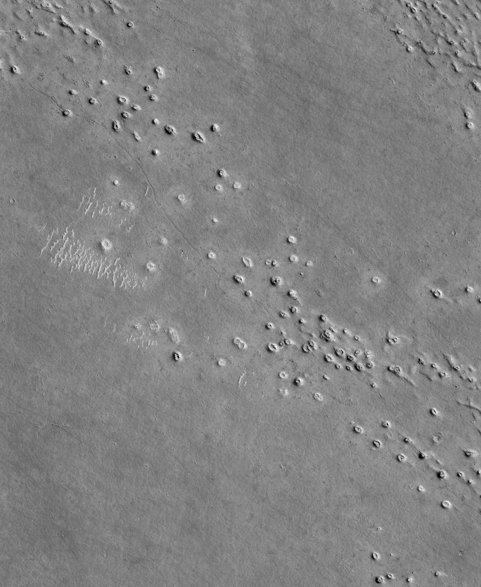
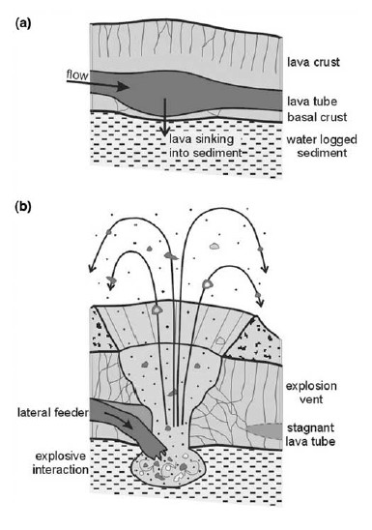
Volcanic Rootless Cones
(Bruno et al., 2004)
1.2 km

Slide 8
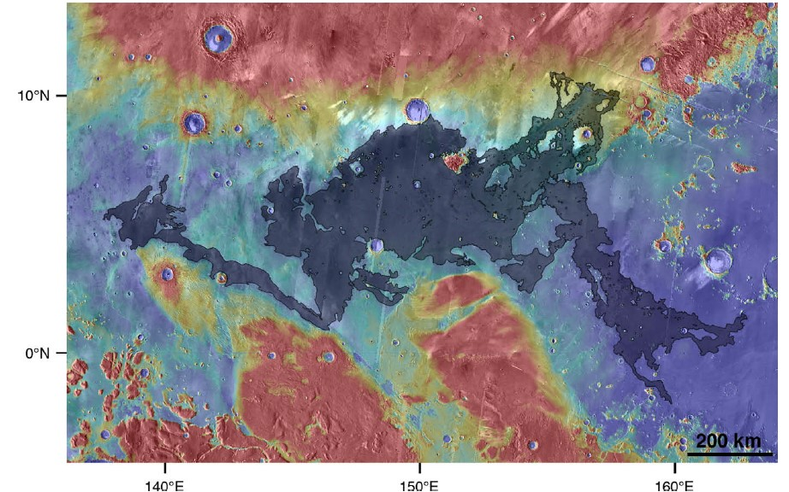
Athabasca Valles Flood Lava
(Jaegar et al., 2010)

Slide 9
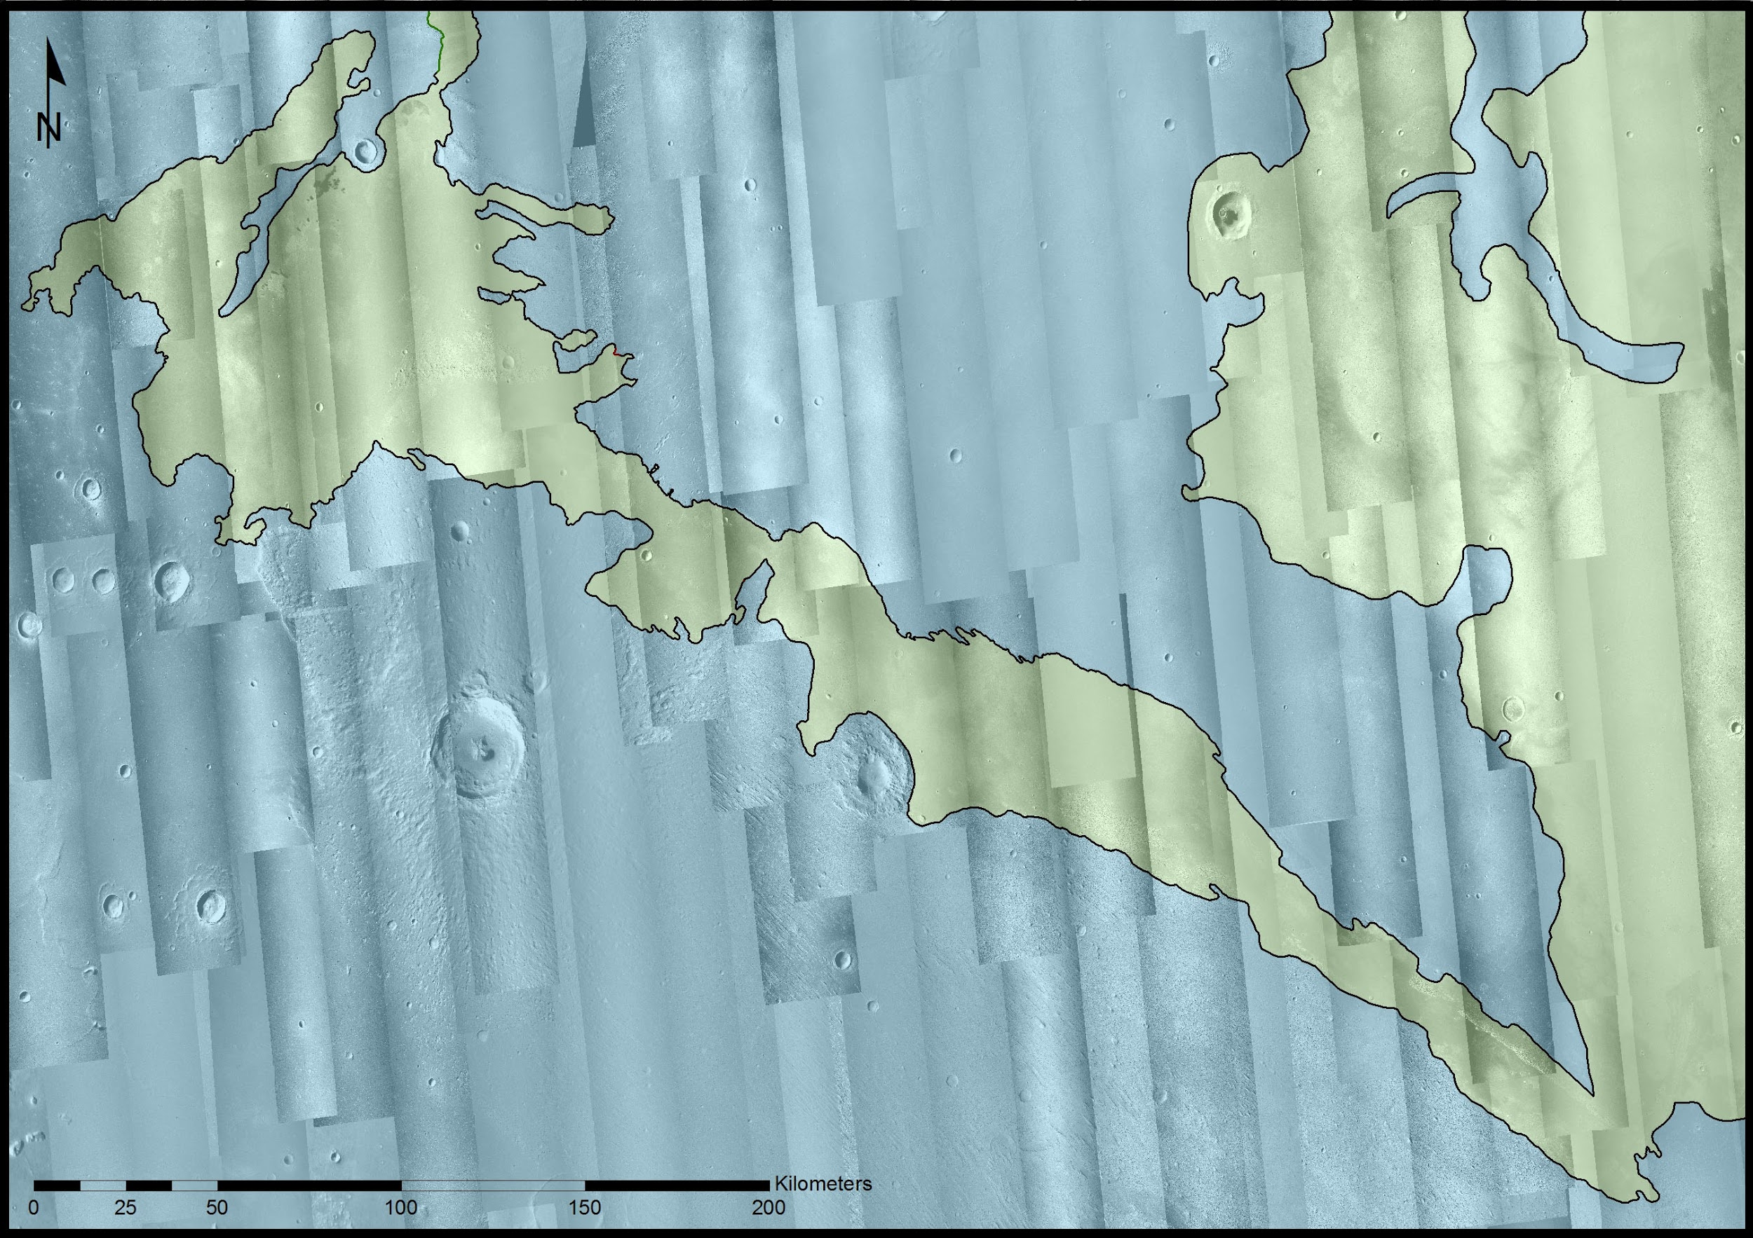
Geologic Mapping
AVFL
MFF

Slide 10
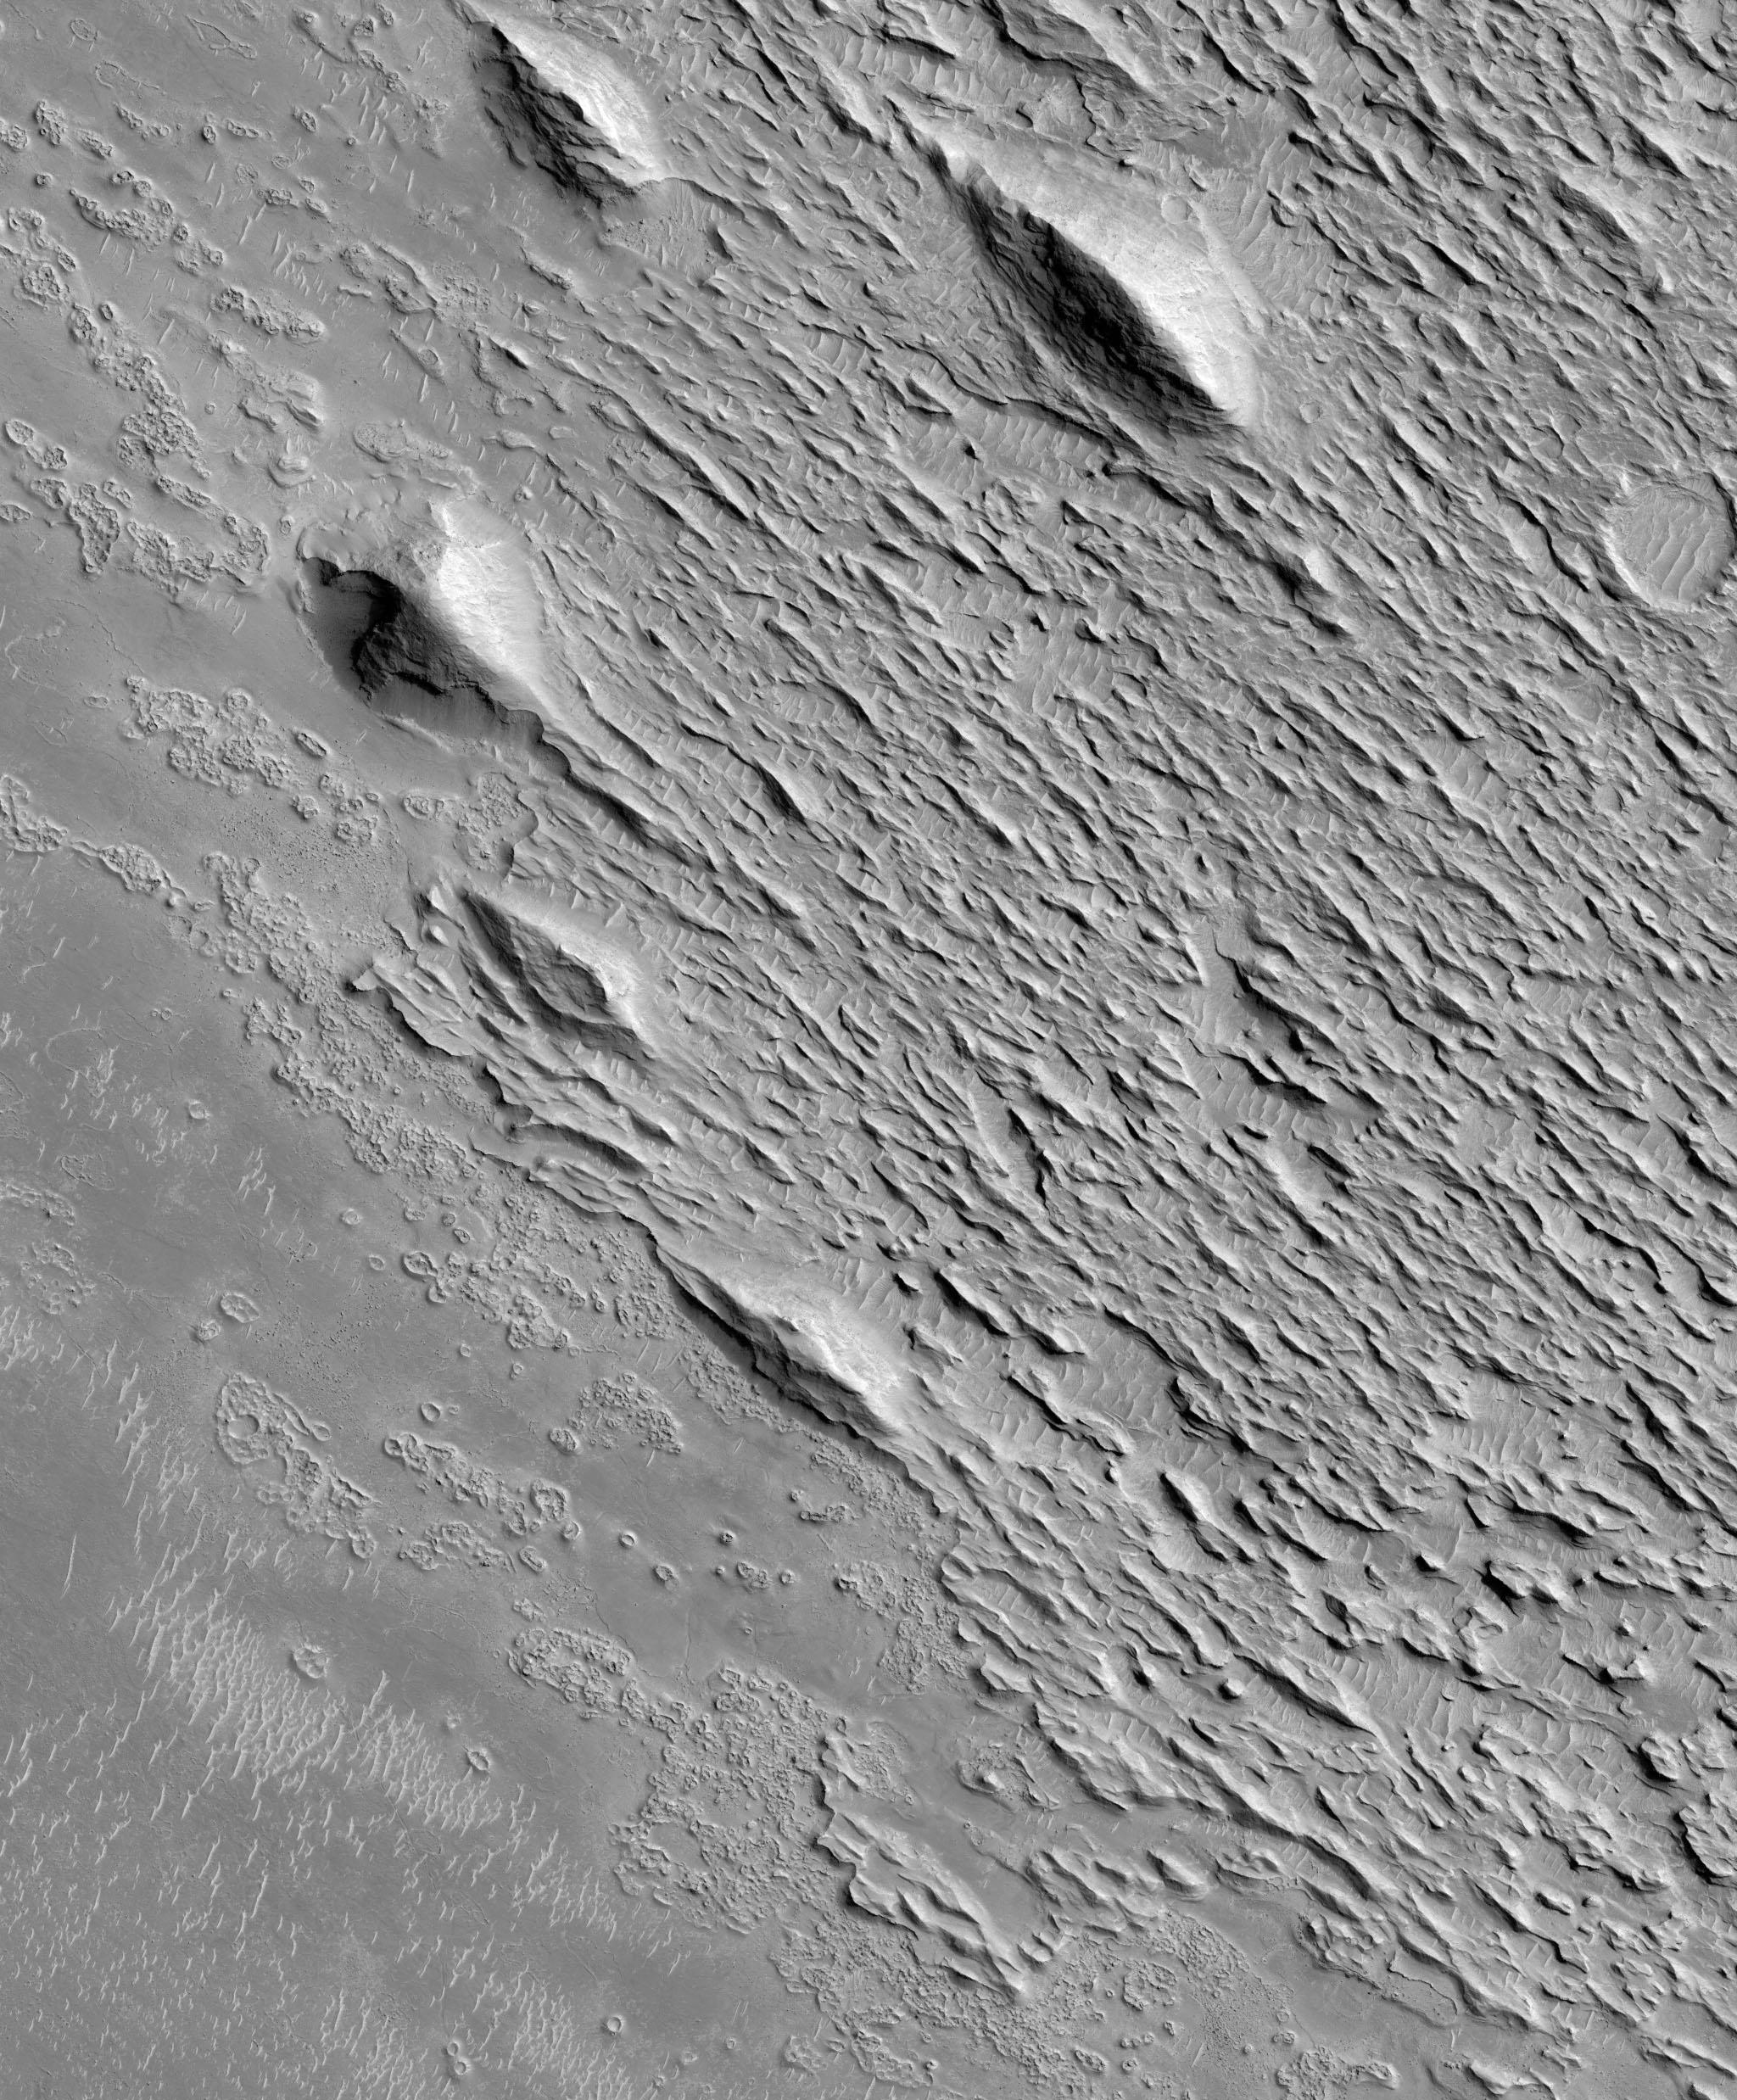
MFF
AVFL
1 km

Slide 11
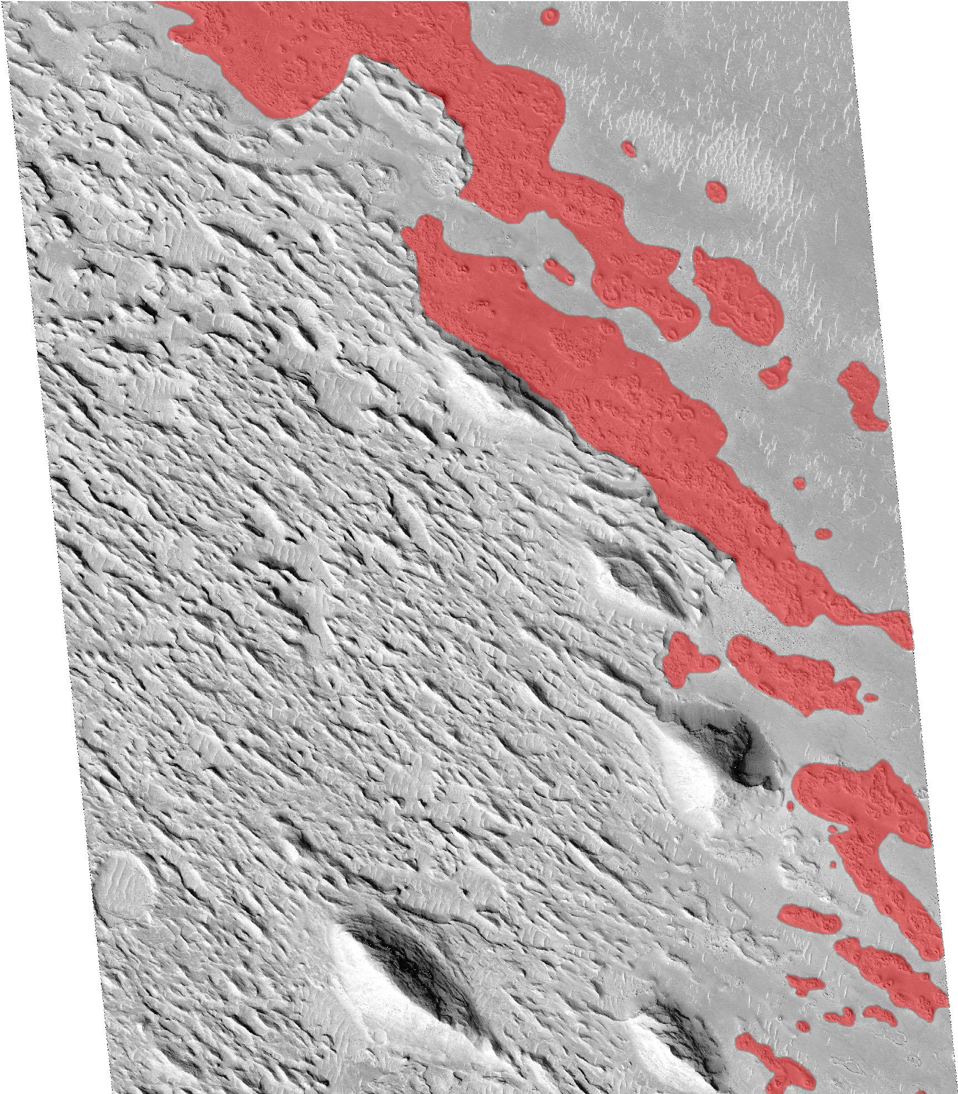
MFF
MFF
AVFL
AVFL
1 km
1 km

Slide 12
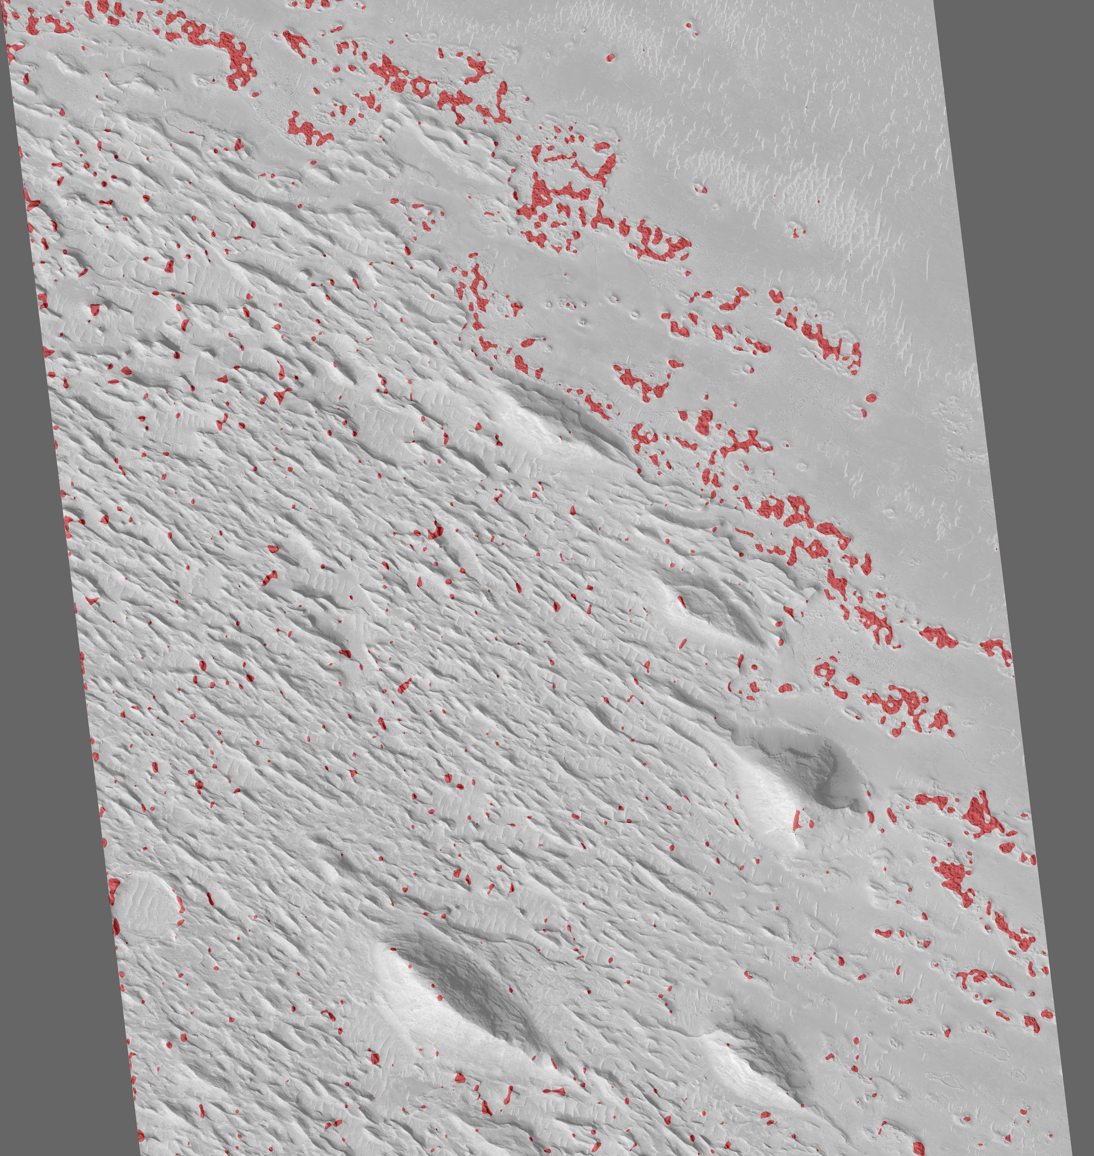
MFF
MFF
AVFL
AVFL
1 km
1 km

Slide 13
Conclusions
The MFF is likely a porous material that allows for volatiles to infiltrate and move around the substrate.
H₂O (liquid or solid) may not have been present within the MFF when the yardangs formed; however, a porous substrate could have hosted H₂O at the time of the AVFL deposition.
Formation of VRCs above lava-mantled yardangs would point towards a recent change in climate that favored the stability of pore-ice within the yardang deposits at the time when they were buried by the AVFL approximately 5 to 20 Ma ago.

Slide 14
Acknowledgements
I would like to thank the NASA Space Grant Consortium for providing me with the opportunity to further advance my knowledge, skills, and abilities. I am grateful for my advisor, Dr. Christopher Hamilton, as well as Dr. Leon Palafox and Dr. Stephen Scheidt. Lastly, I offer my deepest gratitude to all others who supported me during the completion of the project.
Thank you!

